Slide 1






T: +6012 502 3566
E: enquiry@actomate.ai
W: www.actomate.ai
Introduction to R Packages for Data Science
Clement Tan
Actuarial Analyst
24th March 2025
Copyright © Actomate 2025. All rights reserved.

Slide 2
Table of Contents
Contents | Page
A. What are R Packages? | 3
B. Categories of R Packages | 4
C. How to use R Packages? | 5
D. Q&A | 6

Slide 3
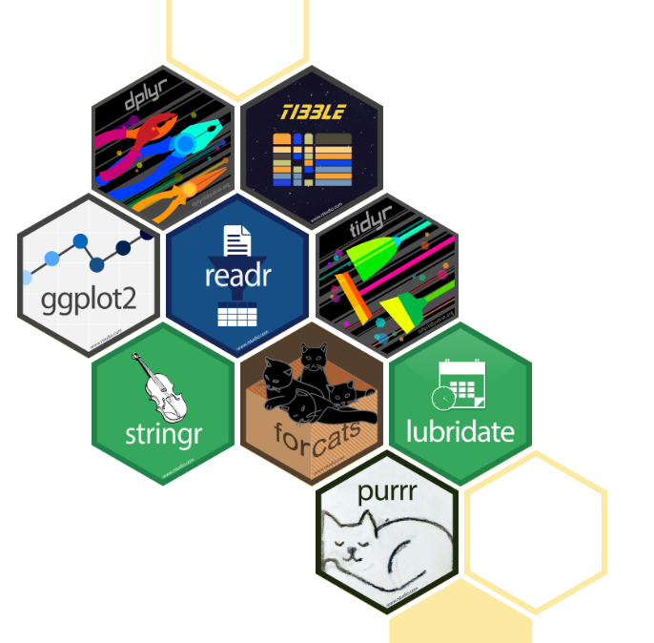
What are R Packages?
R is a powerful language for data science, and its true strength lies in its extensive ecosystem of packages—collections of functions and tools designed to simplify data manipulation, visualization, and modeling
Tidyverse: A collection of R packages designed for data science. All packages share an underlying design philosophy, grammar, and data structures.

Slide 4
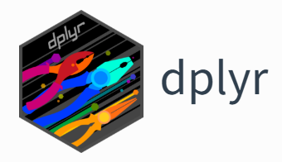
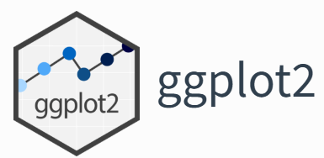
Categories of R Packages
2 main categories we will be covering today: Data Manipulation and Data Visualisation
dplyr is an R package for data manipulation, providing a consistent set of verbs that help you solve the most common data manipulation challenges
ggplot2 is an R package for data visualisation, using a conceptual framework based on the grammar of graphics

Slide 5

How to use R Packages?
Let’s get started in RStudio!

Slide 6


Q&A

